Slide 1


Slide 2
Bytes, Hex & Integer Representation
Representing and manipulating binary data

Slide 3
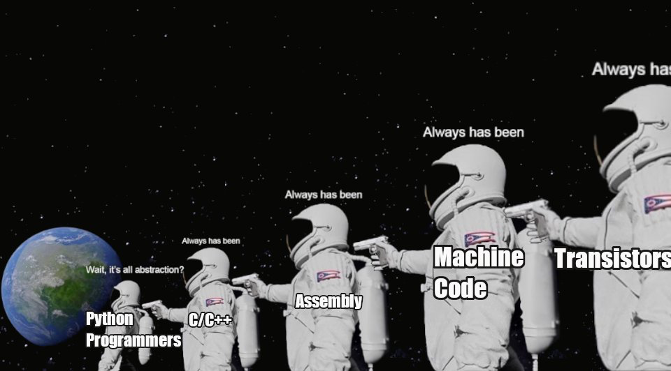
Course Goals

Slide 4
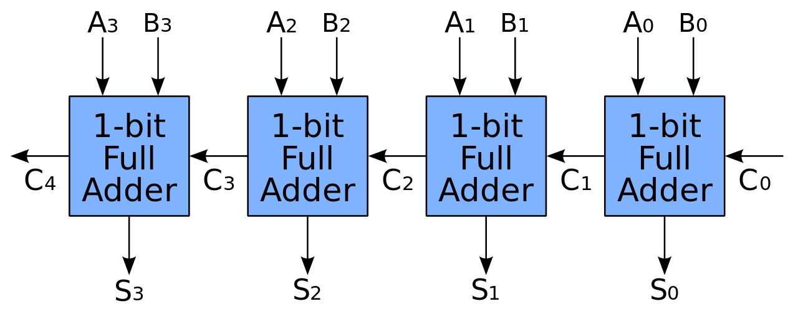
Last Lecture
In the last lecture we looked at
how binary data is stored in the computer
how an operation, addition, is implemented via logical gates
Notes:
Can be found online… but I can’t link to it

Slide 5
Adding Values
Given this adder, what if we wanted to add two binary values together?
0010 + 0001 = ?
0010 + 0011 = ?
1000 + 1000 = ?
Notes:
Can be found online… but I can’t link to it

Slide 6
Representations
We are going to move up a level and consider data representations
At the machine leve, everything is binary
Different interpretive schemes can be imposed on this binary data
Notes:
Can be found online… but I can’t link to it

Slide 7
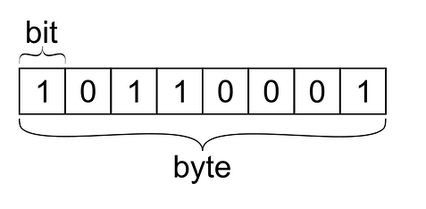
Bytes
The smallest group of bits is known as a byte
A byte is 8 bits
With 8 bits available we can represent 2^8 numbers
0-255 unsigned
Notes:
Can be found online… but I can’t link to it

Slide 8
Bytes
Interpreting this value as an unsigned integer this value is: (10110001)₂ = (1 × 2⁷) + (0 × 2⁶) + (1 × 2⁵) + (1 × 2⁴) + (0 × 2³) + (0 × 2²) + (0 × 2¹) + (1 × 2⁰) = (177)₁₀
Notes:
Can be found online… but I can’t link to it

Slide 9
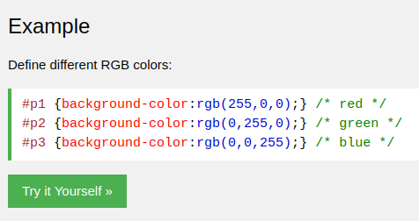
Bytes
You will find the limit 255 in some funny places
CSS color specification
Each color in R, G, B can have a value of 0-255
Notes:
Can be found online… but I can’t link to it

Slide 10
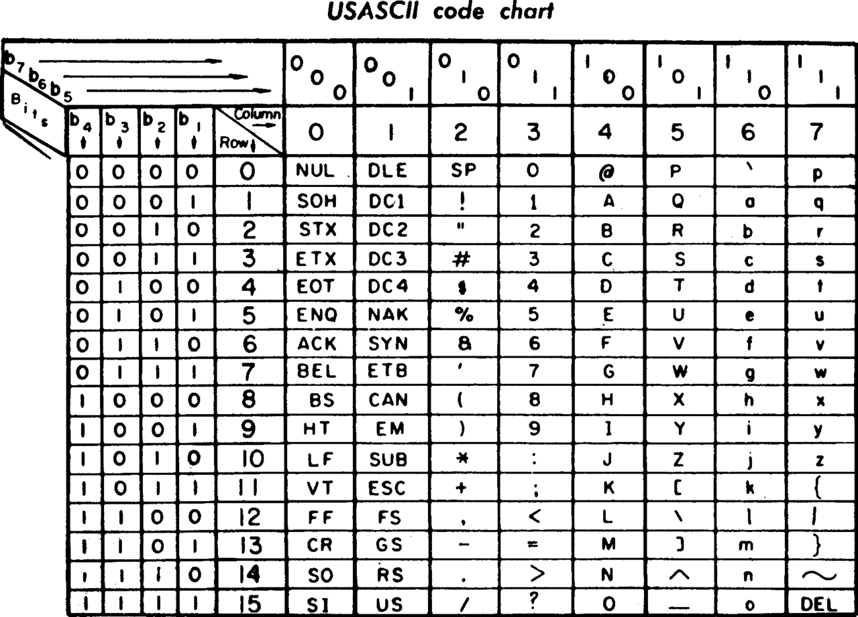
ASCII
ASCII is an example of a representation imposed on bytes
Developed from telegraph code
Work on standard began in 1960
Encodes 128 English characters into 7 bit integers
Notes:
Can be found online… but I can’t link to it

Slide 11
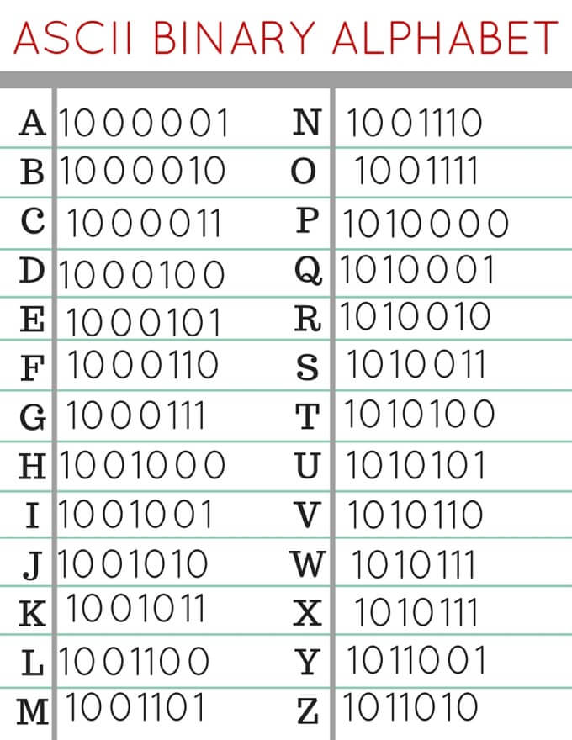
ASCII
ASCII codes are shown at right
When you work with string literals in C, this is what is actually being stored in memory
NB: In C you can treat these as unsigned integers
We do that when converting a numeric char to its actual numeric value in the project!
Notes:
Can be found online… but I can’t link to it

Slide 12
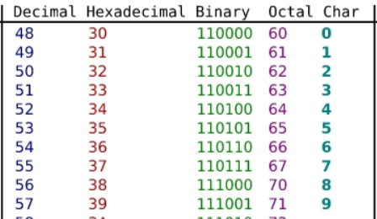
ASCII
OK, characters are just bytes
Those bytes can be interpreted differently, right?
How could you convert the character ‘0’ to the integer value 0?
Notes:
Can be found online… but I can’t link to it

Slide 13
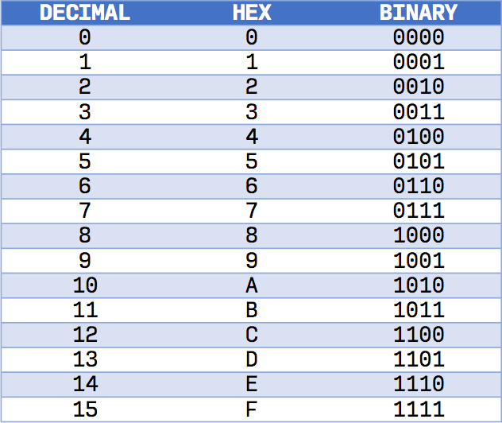
Hex
Hexadecimal is another way to represent binary data
Unrelated to ASCII
Rather, an efficient way to specify groups of 4 bytes
Uses 16 characters to represent a half byte (a nibble)
0-9, then A-F
Notes:
Can be found online… but I can’t link to it

Slide 14
Hex
In written representation, hex is typically prefixed with an 0x:
0x00F
You can use this notation as a literal value in C, Java, etc.
Notes:
Can be found online… but I can’t link to it

Slide 15
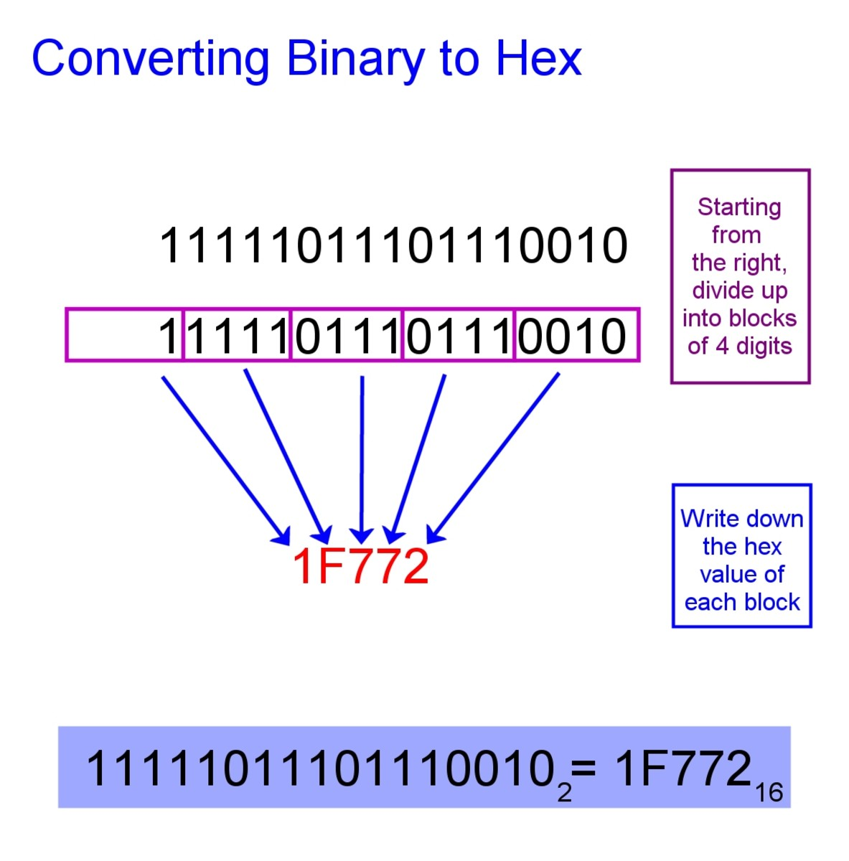
Converting Binary To Hex
Pretty straightforward
Group in nibbles (groups of 4 bits)
0-9 -> converts to the same numeric character
10-15 -> A, B, C, D, E, F
Notes:
Can be found online… but I can’t link to it

Slide 16
Converting Decimal To Hex
A bit more work
If number is < 16, just convert it directly
Else
Divide the number repeatedly by 16, writing down remainders, until value is < 16
The last value is the first number in the hex, add remainders in reverse order
Notes:
Can be found online… but I can’t link to it

Slide 17
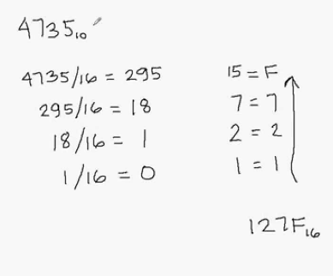
Converting Decimal To Hex
A bit more work
If number is < 16, just convert it directly
Else
Divide the number repeatedly by 16, writing down remainders, until value is < 16
The last value is the first number in the hex, add remainders in reverse order
Notes:
Can be found online… but I can’t link to it

Slide 18
Unsigned Integers
Recall how unsigned integers in binary works (10110001)₂ = (1 × 2⁷) + (0 × 2⁶) + (1 × 2⁵) + (1 × 2⁴) + (0 × 2³) + (0 × 2²) + (0 × 2¹) + (1 × 2⁰) = (177)₁₀
Notes:
Can be found online… but I can’t link to it

Slide 19
Signed Integers
How could we represent signed integers?
Option 1: a sign bit
By convention, let’s say that the most significant bit is the sign bit
What number is this using this encoding?
Notes:
Can be found online… but I can’t link to it

Slide 20
Signed Integers
Interpreting this value as an unsigned integer this value is: (10110001)₂ = (-1) * ( (0 × 2⁶) + (1 × 2⁵) + (1 × 2⁴) + (0 × 2³) + (0 × 2²) + (0 × 2¹) + (1 × 2⁰) ) = (-49)₁₀
Notes:
Can be found online… but I can’t link to it

Slide 21
Signed Integers
Same bits as unsigned 177
The two different values we assigned to this bit pattern are the encoding we are using to interpret them
Notes:
Can be found online… but I can’t link to it

Slide 22
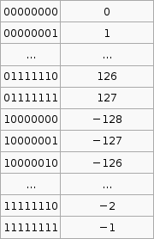
Signed Integers
Signed integers typically do not solely use a sign bit
Instead, they use an encoding known as 2’s complement
The encoding is shown at right
-128 is 10000000
-1 is 111111111
Notes:
Can be found online… but I can’t link to it

Slide 23
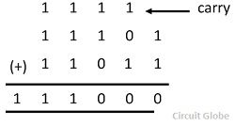
Binary Addition
Why on earth?
To understand why, you need to understand how binary math works
Let’s look at addition
Note the carry bit from our earlier discussion on addition
Notes:
Can be found online… but I can’t link to it

Slide 24
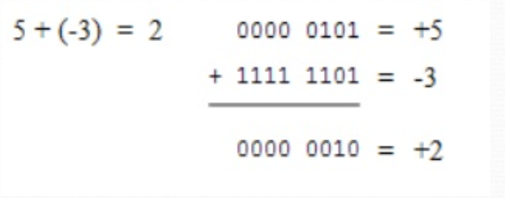
Binary Addition
Let’s add 5 and -3
5 rep: 0000 0101
-3 rep: 1111 1101
Woah, just normal binary math gives us the correct result!
2’s complement has this wonderful feature
Math with negative numbers works in the same logical manner
Notes:
Can be found online… but I can’t link to it

Slide 25
Binary Addition
Converting a number to 2’s complement:
Start with the positive binary rep
Subtract 1
Flip the bits
Getting -3
Start with 3 = 0000 0011
Subtract 1, gives 2 = 0000 0010
Flip the bits = 1111 1101
Notes:
Can be found online… but I can’t link to it

Slide 26
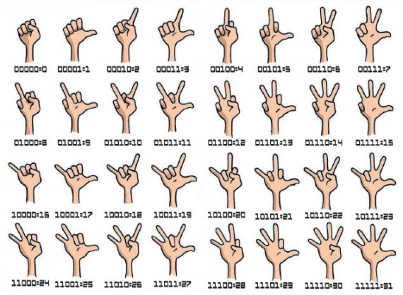
Binary Finger Counting
Did you know you can count to 31 on one hand?
Let’s try it out
Notes:
Can be found online… but I can’t link to it

Slide 27
Bytes, Hex & Integer Representation
We took a look at how binary data can be encoded
We looked as ASCII, a character encoding
We looked at hexadecimal encoding
We looked at integer encoding
We discussed 2s complement, a scheme for encoding signed integers
2s complement has a really nice property of allowing standard addition to work with negative numbers without a change
REMEMBER: IT’S JUST BITS

